Slide 1

Sprint review Sprint: 26 – Team: CanNot…t
Confidential Material – For intended audience only and not for broad distribution

Slide 2


Content
The team
Sprint summary
Burn down chart
Sprint Bugs/Problem
Statistics
Documents
Notes:
30 min

Slide 3

The Team
Product Owner
Iwan Spillebeen
Scrum Master
Toon
Team
Thong
Tob
Tonge
Lek
KA
Med
Win
Waleed
Nanees
Air

Slide 4
Sprint Summary
Sprint 26 Goals
Accomplishments
Committed functionalities: 36 US, 1 Non-US
Committed Story Points: 68 points
Additional : 2 US, -2 US, 5 Non-US
UAT Faults: 0
Story points completed: 67 points
Completed: 36 US, 6 Non-US
Unfinished Stories: 0 US
Story points remaining: 0 points
Continuation and completion of product management
Update of sonarqube reporting
Notes:
Continuation (เคินทินิว´เอ ช’น) Accomplishments (อะ-คอม-พรีชเมนส)
Additional -> We added 2 user stories and also moved 2 user stories to backlog and creates new 5 tasks
What was we complete ? -> We have finished 67 points, 36 User stories and 6 Tasks, We didn't have user stories unfinished.

Slide 5
Continuation and completion of product management
Product list page
Improved search functionality
Improved sorting and functionality.
Added new column Product GUID (Globally Unique Identifier)
New actions for easy navigation in product details.
Product detail page
Validation, KYC, AML tabs working.
New alert box.
Update of sonarqube reporting
Added code coverage feature every projects.
Notes:
I will detail of the topics
Product list page
In this sprint we improved the search functionality, we added a drop down list for some items to make search more easy
We also improved sorting by implementing new design (we added new buttons for sort by ascendant and descendant)
There’s a new column appearing (อะ-พริว-ลิง) in the product list page which is Product GUID.
For the action menu, there’s now 3 new actions (Validator sequence, KYC sequence, AML sequence) to navigate inside the tabs in product details
Product detail page
We have now the 3 tabs Validation, KYC and AML working and showing sequences of the product. These tabs let’s the user edit the flow if he wishes (วิ-ชิส) to do so. The user has to save before leaving or he will be alerted that he’s leaving the page without saving.
We updated new design of alert box.
*** When I demo พูดตอนต้องการจะบอกสีในหน้า tab validator
If the checkpoint is false usually we go to TBI, but sometimes we need to run more checks, that’s why in the UI we have different color for not TBI false case.
Same thing for END, we show a different color so the user can see it’s different.

Slide 6
Sprint Bugs/Problem
Not have enough audit trail information.
Notes:
So we couldn't to finish audit trail service and audit trail in product

Slide 7
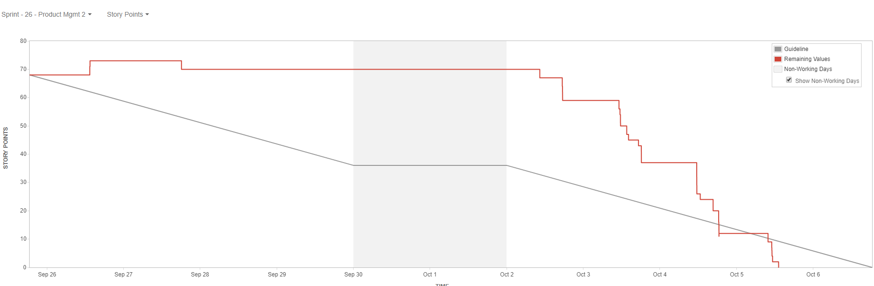
Burn down chart
Notes:
In the first phase (เฟซ) we have to spend time doing in back-end for provide data to front-end so that we couldn’t to burn point.

Slide 8
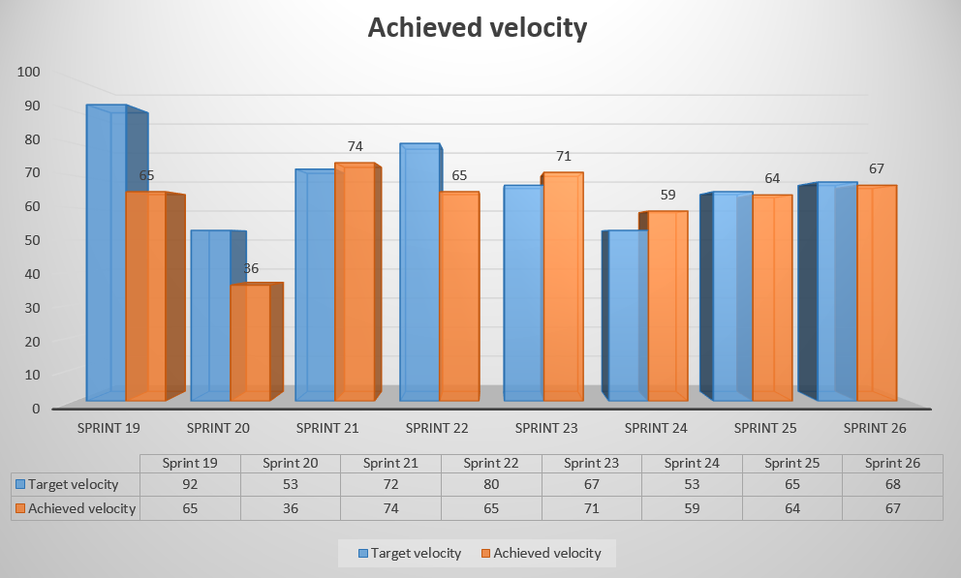
Sprint Statistics
Target velocity: 67 Achieved velocity: 68
Notes:
The target velocity is 67 and achieved (แอ๊ค-ชีฟ) velocity is 68

Slide 9
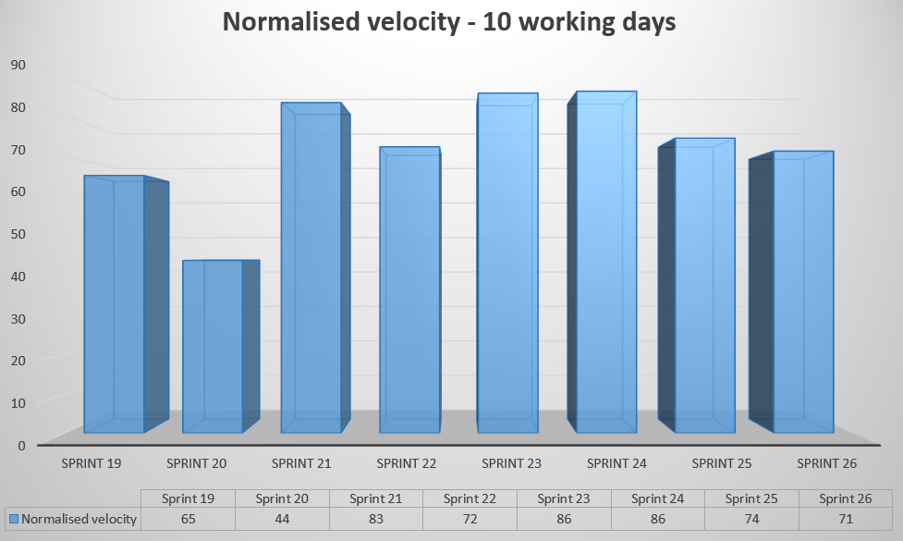
Sprint Statistics
Notes:
Normalized (โนโมไลส์ท) velocity is 71

Slide 10
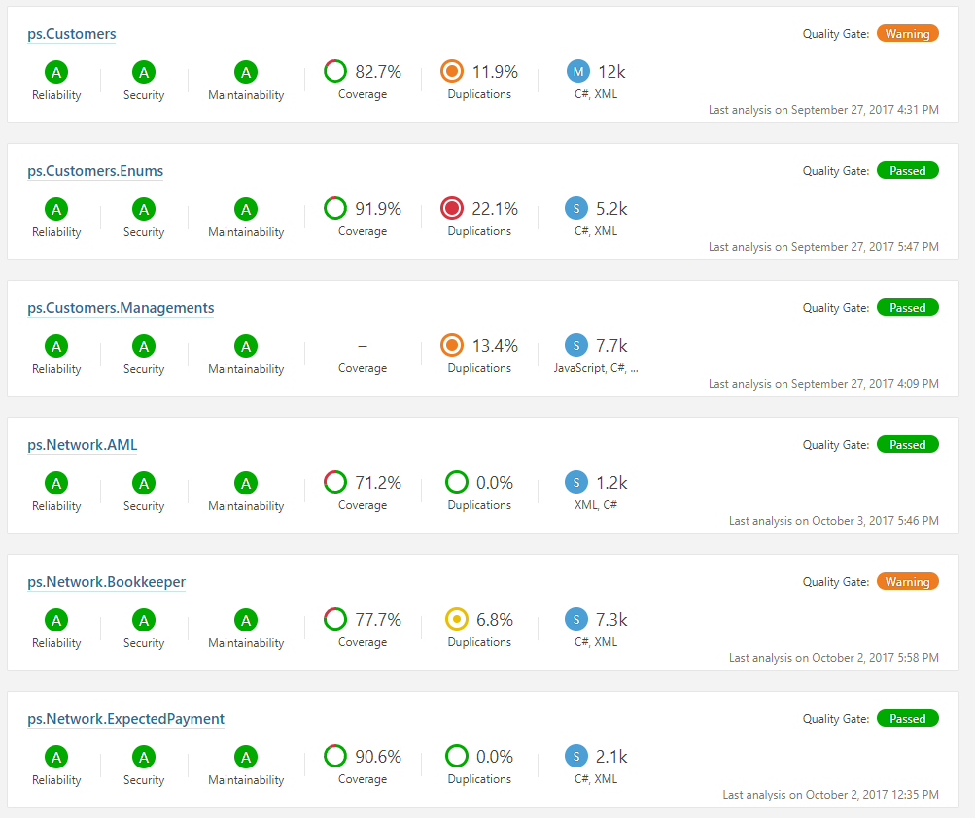
Quality Statistics

Slide 11
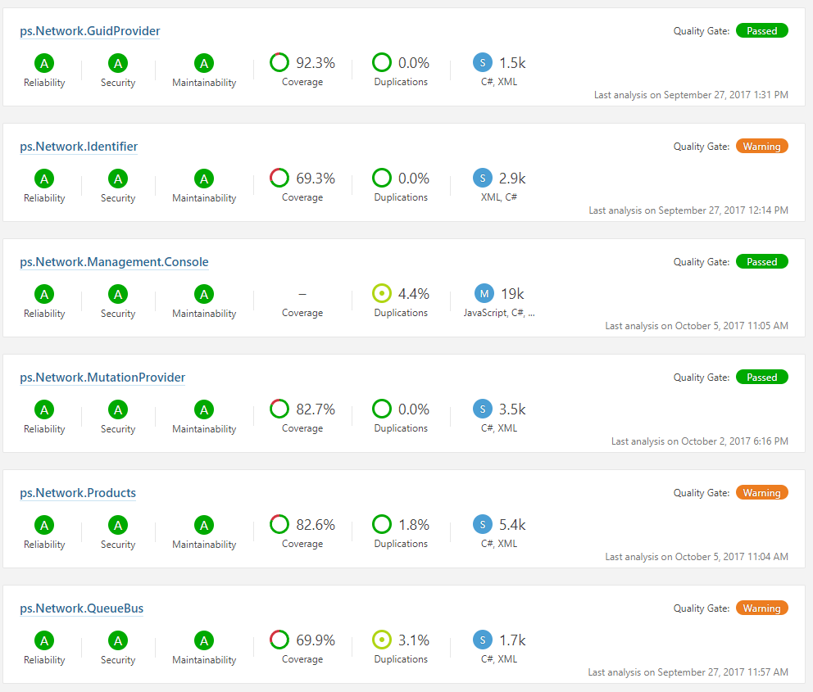
Quality Statistics

Slide 12
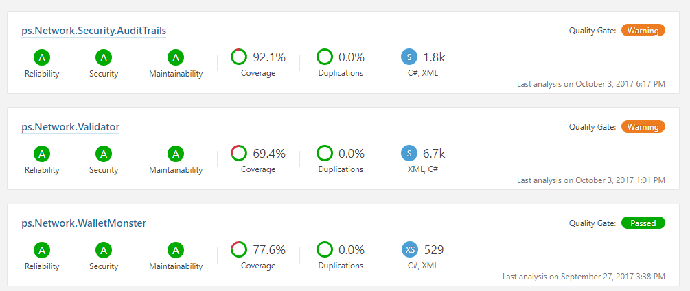
Quality Statistics

Slide 13

Documents
Documents produced
Path:
Product
Notes:
5

Slide 14
THANK YOU

